Slide 1
What is WIC?
An overview of the Welcoming and Inclusive
Communities Initiative

Slide 2
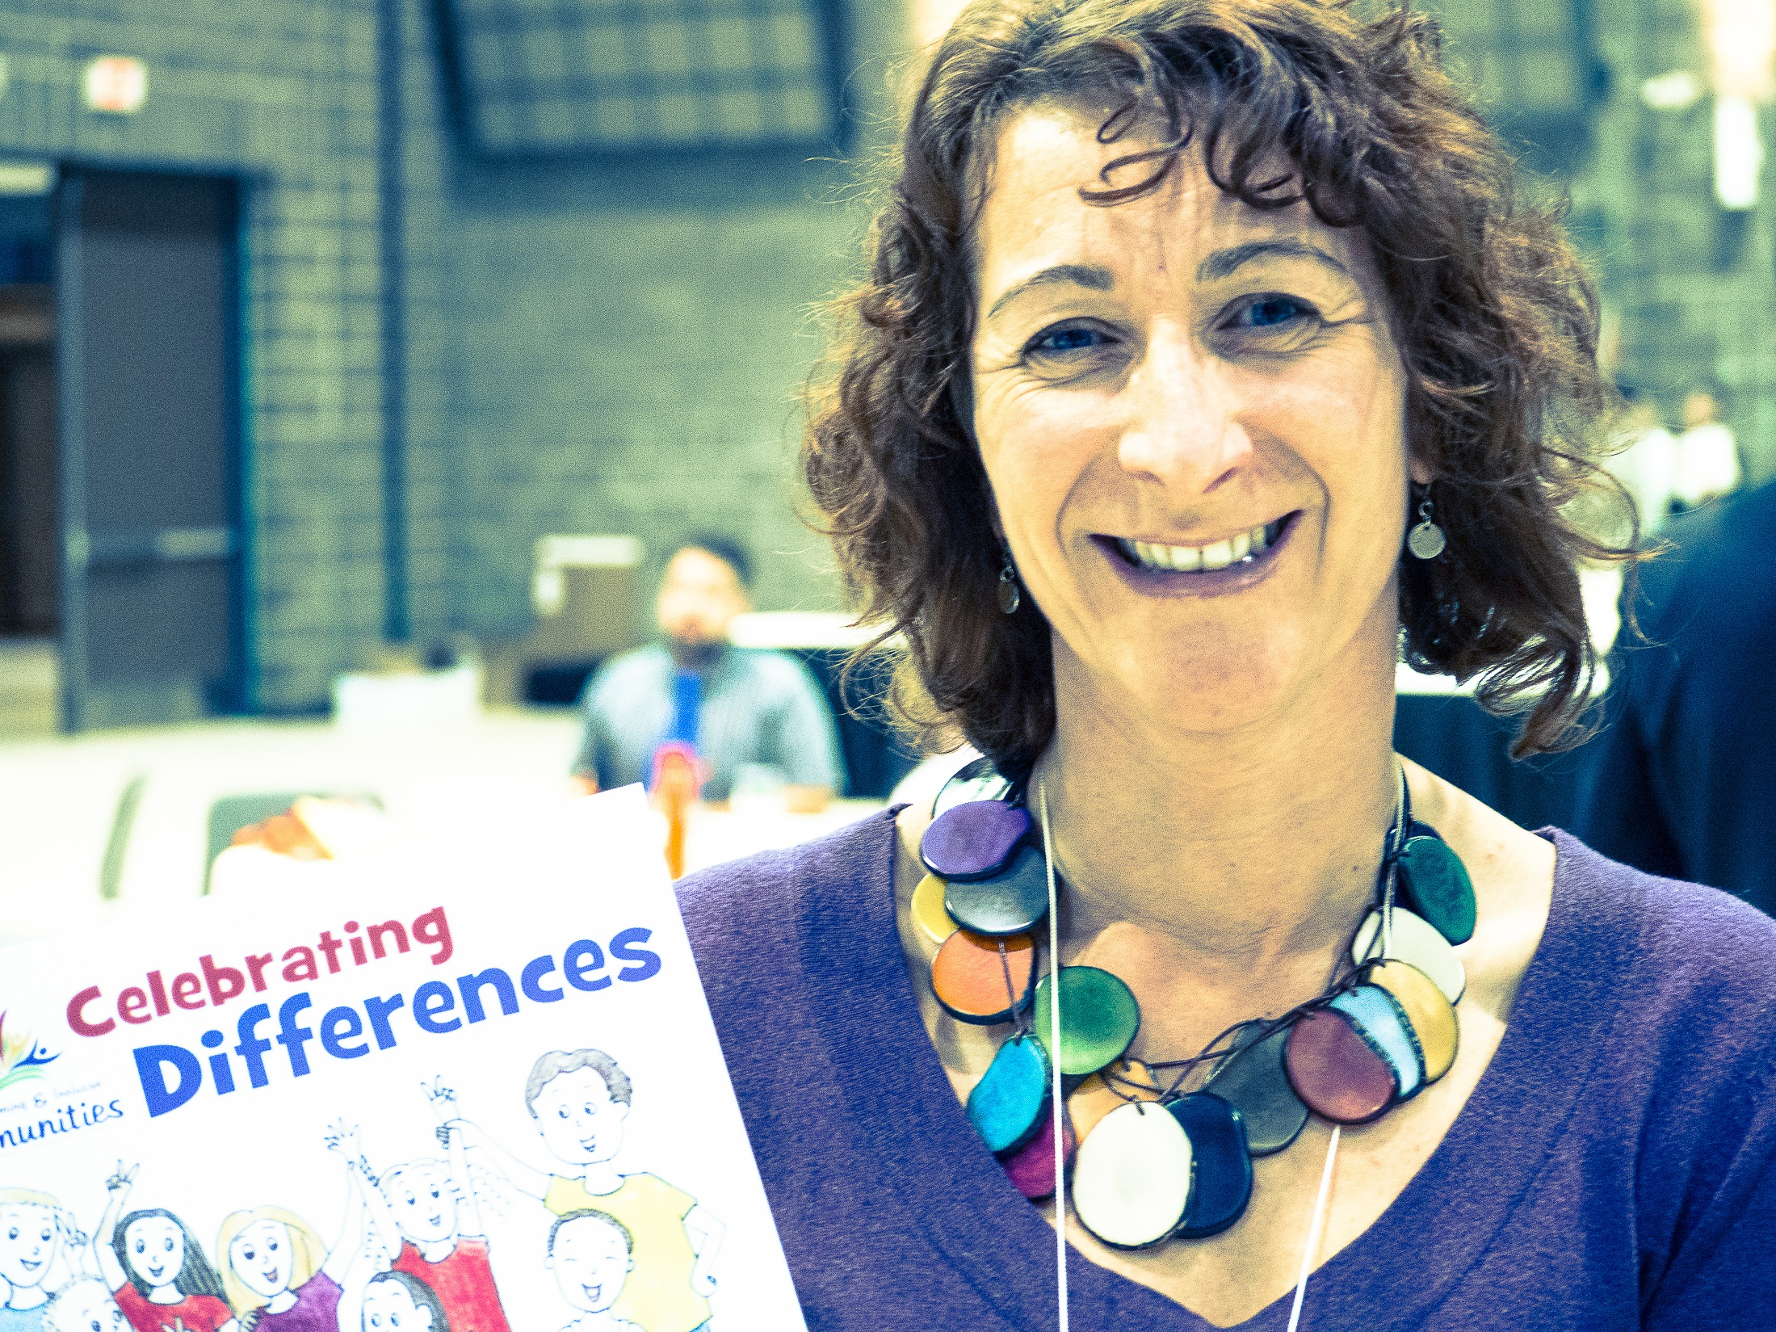
Being welcoming and inclusive is no longer an option.
Notes:
A Welcoming and Inclusive Community (WIC) initiative is no longer an option for Alberta’s municipalities. It is a necessity. Not only to comply with the increasing legal requirements around access, municipalities must now focus on WIC principles for their long-term sustainability. As the population changes and as immigration becomes the main source of growth, local governments that undertake WIC initiatives will be more competitive and prepared for the future.

Slide 3
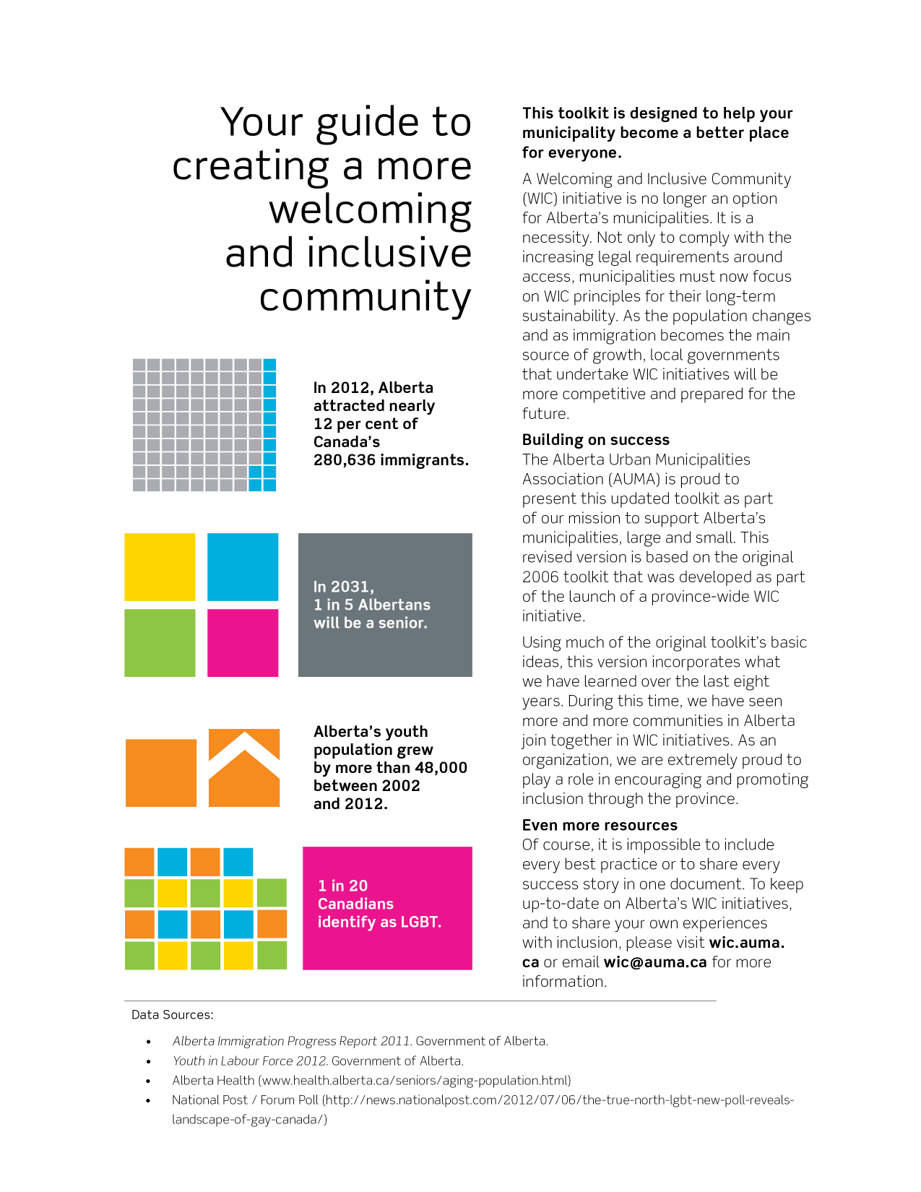
Notes:
Alberta municipalities have become increasingly aware of issues around dwindling populations and labour shortages. Attraction and retention strategies can help with growth. Sometimes new arrivals encounter challenges adapting to their new environment. Newcomers will be more attracted to prepared communities that make them feel welcome and included.
Statistics: Alberta Immigration Progress Report 2011. Government of Alberta.

Slide 4
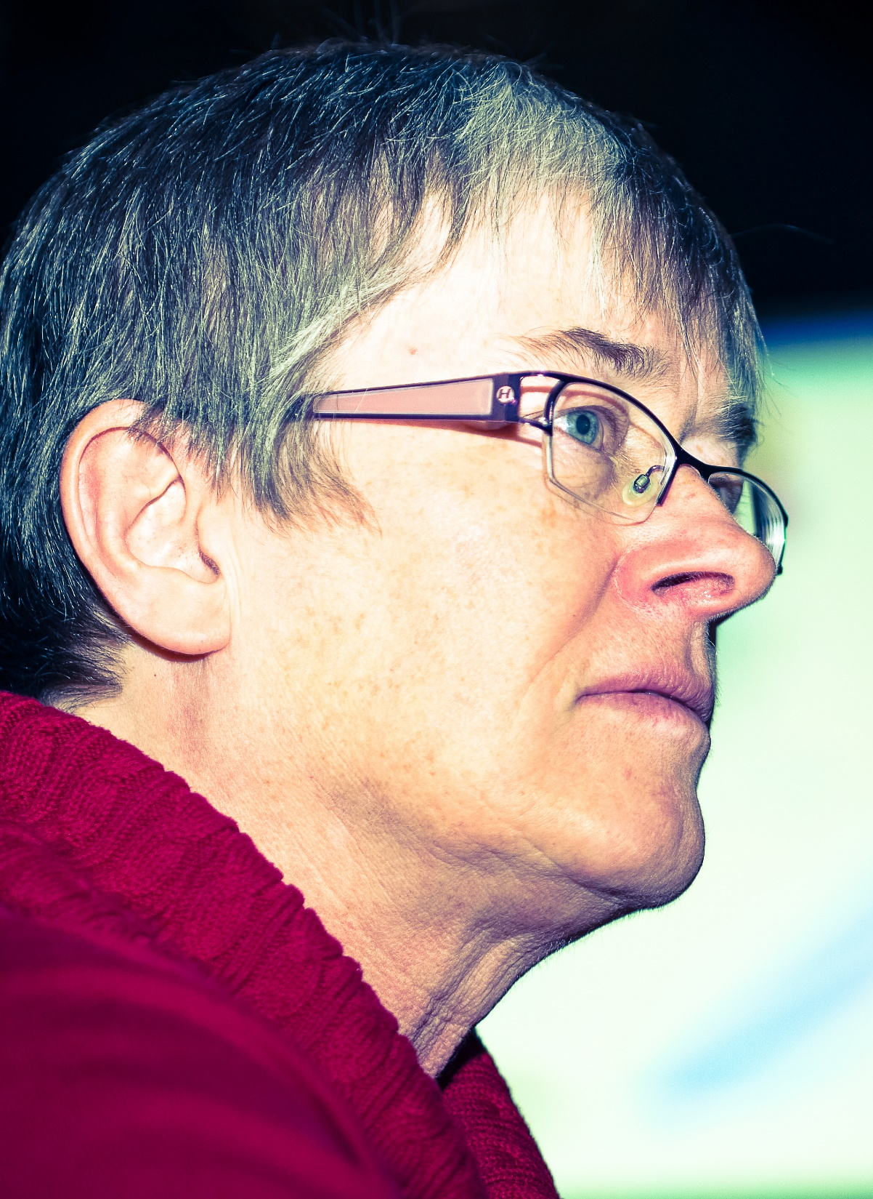
Notes:
It is estimated that by 2031 there will be more than 923,000 seniors in Alberta – about one in five Albertans. As the population ages, communities must adapt not only to accommodate seniors’ needs but also to recognize the unique opportunities around attracting and retaining this important demographic.
Statistics: Alberta Health (www.health.alberta.ca/seniors/aging-population.html)

Slide 5
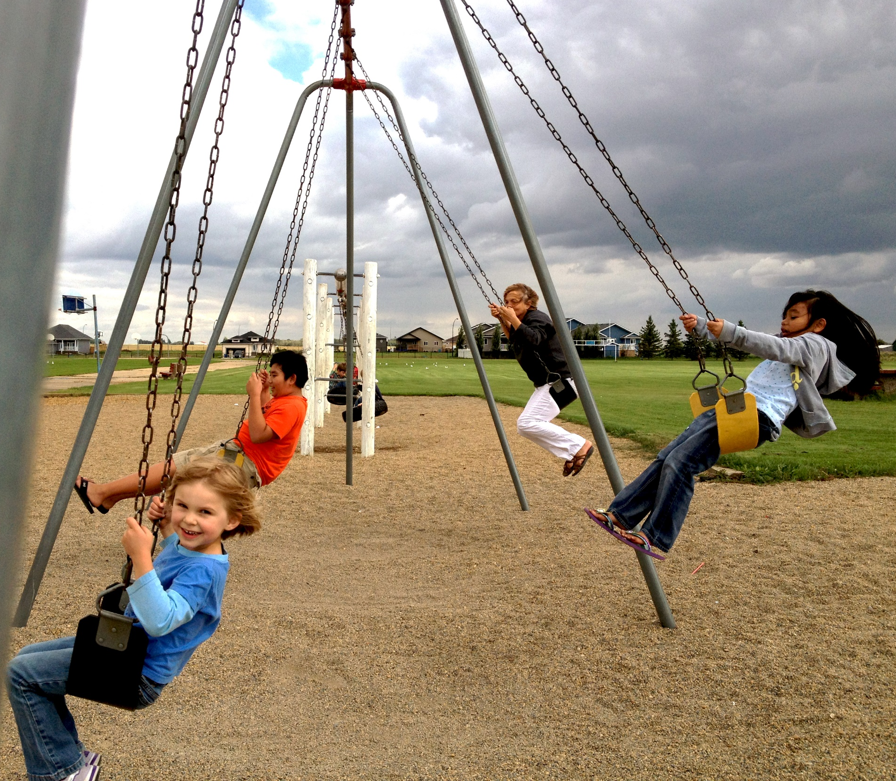
Notes:
In 2012, Alberta’s youth made up 15.4% of the labour force and 14.7% of employed Albertans. To retain and attract youth, communities must make them feel welcome and provide opportunities for young people to participate and create.
Statistics: Youth in Labour Force 2012. Government of Alberta.

Slide 6
Notes:
The abbreviation LGBT refers to lesbian, gay, bisexual, and transgendered people. LGBT people often feel excluded from our communities due to overt (homophobia) and systemic (heterosexism) experiences of discrimination. In 1996, the Canadian Human Rights Act was amended to prohibit discrimination on the basis of sexual orientation. In 2009, Alberta included sexual orientation in the Alberta Human Rights Act.
Statistics: National Post / Forum Poll (http://news.nationalpost.com/2012/07/06/the-true-north-lgbt-new-poll-reveals-landscape-of-gay-canada/)

Slide 7

Legislation
and accessibility
Notes:
Being a welcoming and inclusive community requires a recognition of the differing abilities of community members and taking action to ensure that all residents are able to actively participate in the social, cultural and economic life of the municipality. This may include, for example, ensuring barrier-free access to recreation facilities, accommodating differing needs in the municipal workplace and providing education on health policies for municipal staff. The Alberta Human Rights Act prohibits discrimination on the grounds of physical and mental disability.

Slide 8
WIC is about reflecting the diversity of our community into our governance, planning and service delivery.

Slide 9
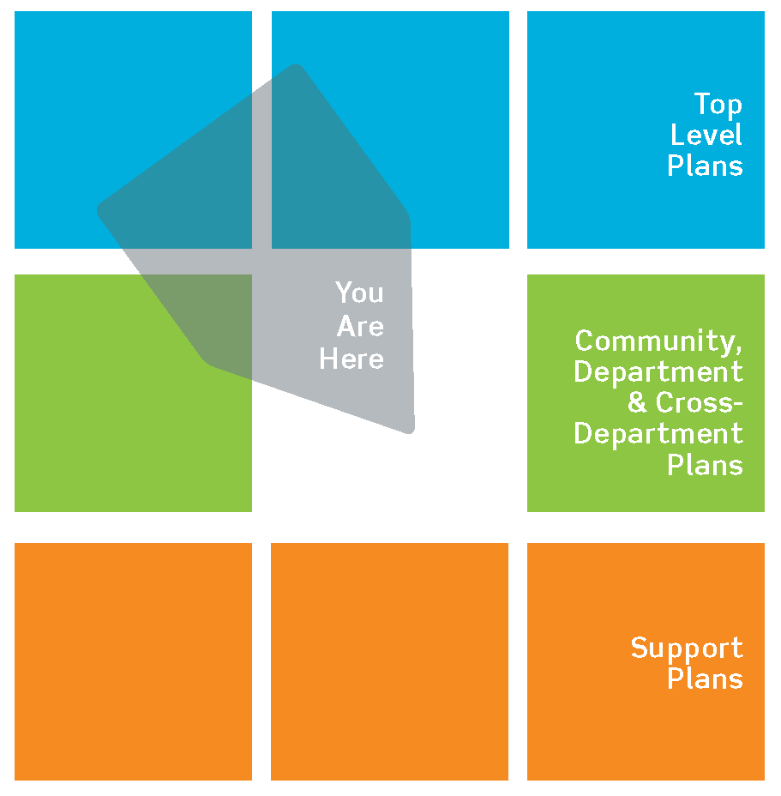
Where
WIC Fits
Notes:
While specific programs are often necessary, ultimately, the WIC concept is about incorporating the diversity of residents within your community into your overall governance, planning and service delivery. Successful municipalities work to engage as much of the community as possible in their planning and implementation efforts.

Slide 10
Why should we do it?

Slide 11
Why should we do it?
Reflect our community’s diversity
Notes:
For this program to work, we need as much input from the community as possible. Based on this feedback and the funds available, we will create a program that represents who we are as a community and celebrates many of the initiatives that are already underway.

Slide 12
Why should we do it?
Reflect our community’s diversity
Create a safer community
Notes:
We want everyone to feel welcome in our community. Communities that are committed to promoting inclusion and equity and reducing racism and discrimination, experience an increased sense of cohesiveness and belonging. When people feel welcome and are involved in the community, safety and security are enhanced. We want to earn the trust, loyalty, and respect of our municipal employees and our citizens by showing that we take diversity seriously, and are committed to actions that further access, equity, inclusion and justice for all.

Slide 13
Why should we do it?
Reflect our community’s diversity
Create a safer community
Increase efficiency
Notes:
Improved service deliver, more integrated planning, fewer complaints, and reduced vulnerability to liability in the event of discrimination or harassment complaints, are all potential benefits resulting from our WIC initiative.

Slide 14
Why should we do it?
Reflect our community’s diversity
Create a safer community
Increase efficiency
Comply with the law
Notes:
Under the Municipal Government Act, municipalities are tasked with: Providing good governance, Providing services and facilities that are necessary in the opinion of council; and, Developing safe and viable communities.
We need to consider the legal liability of not being inclusive. International, federal, and provincial laws such as the International Convention on the Elimination of All Forms of Racism (to which Canada is a signatory), the Canadian Charter of Rights and Freedoms, the Canadian Human Rights Act, the Canadian Multiculturalism Act and the Alberta Human Rights, Citizenship and Multiculturalism Act underline this necessity.

Slide 15
Why should we do it?
Reflect our community’s diversity
Create a safer community
Increase efficiency
Comply with the law
Economic development
Notes:
We are not only competing against other nations for skilled workers and professionals, but also with other provinces / territories and municipalities. A welcoming and inclusive community will give us a competitive advantage and help set our community apart when potential new citizens are deciding where to live and work. We want to attract newcomers who want to build new businesses and create more opportunities for our community.

Slide 16
For
example
What other Alberta communities have
done to become more welcoming and inclusive.

Slide 17
For example
Staff training
What other Alberta communities have
done to become more welcoming and inclusive.
Notes:
The Regional Municipality of Wood Buffalo has invested significant resources in training their staff to be more welcoming and inclusive. They have both Level 1 and 2 Cultural Awareness that has a strong focus on Aboriginal Culture and one of their local Aboriginal leaders teaches the courses. The municipality also offers an all day workshop on Diversity Training.

Slide 18
For example
Staff training
Relationship building
What other Alberta communities have
done to become more welcoming and inclusive.
Notes:
A strategy to build inclusion and equity is most successful when it is owned and developed by the local community, the groups in that community and the institutions that serve that community. Community engagement, involvement of stakeholders, and open and visible processes of planning and discussion, are all key ingredients in promoting this ownership. Municipalities cannot deliver on inclusion and equity alone.
Partnerships, either informal alliances or formally constituted bodies, are key to making progress. These partnerships are most effective when there is a commonly defined vision, which brings together potential institutional and community stakeholders.
The Municipality of Innisfail believes that relationship building is very important. They ask newcomers what they need and then help to meet the need. The municipality has support for families moving in (furniture, clothing, etc.). They also offer courses in ESL, preparation for winter, buying a car, and getting a driver’s license.
The City of Grand Prairie is working to ensure that there is access to quality English as Second Language (ESL) opportunities for newcomers. They are also creating a welcoming package for newcomers.
The City of St. Albert has included Cree on their French and English street signs and the historical St. Albert Trail. In addition, the mayor and council are currently working to get more women in politics. The City of Brooks’ Protective Services Department has created a fire safety orientation program in a variety of different languages. The city itself has created photo books to help with patrons with whom there may be a language barrier.
The Lakeland Region includes the municipalities of Lac La Biche, Cold Lake, and Bonnyville. Independent Welcoming Communities Committees have been established in each of the municipalities; looking towards the development of a regional approach to tackling issues. In particular, Cold Lake has completed an community social needs assessment and has developed a quick reference resource poster to tell people where they can access services.

Slide 19
For example
Staff training
Relationship building
Combat racism
What other Alberta communities have
done to become more welcoming and inclusive.
Notes:
The City of Edmonton council has approved a Racism Free Edmonton Action Plan and multi-stakeholder Racism Free Edmonton Management Committee. The project includes a website, anti-racism education for leaders and groups and a public awareness campaign.
The City of Grand Prairie is working to ensure that there is access to quality English as Second Language (ESL) opportunities for newcomers. They are also creating a welcoming package for newcomers.
Other communities have established an annual report card on racism and hate crimes within the community. The report card could identify what has worked in addressing hate crimes in the community and what may need to be done in the future to address this matter.

Slide 20
For example
Staff training
Relationship building
Combat racism
Link to new or existing policies
What other Alberta communities have
done to become more welcoming and inclusive.
Notes:
Positioning the work within broader municipal agendas such as Municipal Sustainability, Economic Development, Business Planning, Citizen Engagement, and/or Welcoming and Retaining New Immigrants, increases efficiency as well as effectiveness.
It is equally important to link with other community-based initiatives designed to increase access, integration, inclusion, participation and equitable outcomes for minority individuals and communities. We all know how the “silo approach” places undue stress on limited resources and people.

Slide 21
For example
Staff training
Relationship building
Combat racism
Link to new or existing policies
Come Together Alberta
What other Alberta communities have
done to become more welcoming and inclusive.
Notes:
AUMA’s WIC Network has materials, templates and guidelines available to promote the idea of welcoming and inclusive communities. The kit is designed to help municipalities create high quality and attractive promotional materials to spread the word about WIC-related initiatives. Materials such as a pledge board and a festival guide can help your municipality celebrate WIC accomplishments and educate the public at the same time (wic.auma.ca).

Slide 22
For example
Staff training
Relationship building
Combat racism
Link to new or existing policies
Come Together Alberta
Events
What other Alberta communities have
done to become more welcoming and inclusive.
Notes:
Events are an excellent way to partner with agencies and community groups. One-off events do not require extensive commitment from groups with stretched resources, and can be a ‘test case’ for longer-term partnerships. They can also offer concrete wins so that people can see their successes and be more inclined to work together again. An easy way to ease into events is by recognizing or joining in existing cultural celebrations.
The City of Lethbridge has hosted a number of diversity events, developing the Lethbridge Urban Aboriginal Community Plan as well as the Building Bridges: A Welcoming and Inclusive Lethbridge Community Action Plan.

Slide 23
For example
Staff training
Relationship building
Combat racism
Link to new or existing policies
Come Together Alberta
Events
Awards & Recognition
What other Alberta communities have
done to become more welcoming and inclusive.
Notes:
Recognizing the work and courage of those who have relocated to your community or those who have helped others immigrate is important. Providing awards and recognition for organizations or individuals or initiatives that are contributing to building a racism free community.

Slide 24

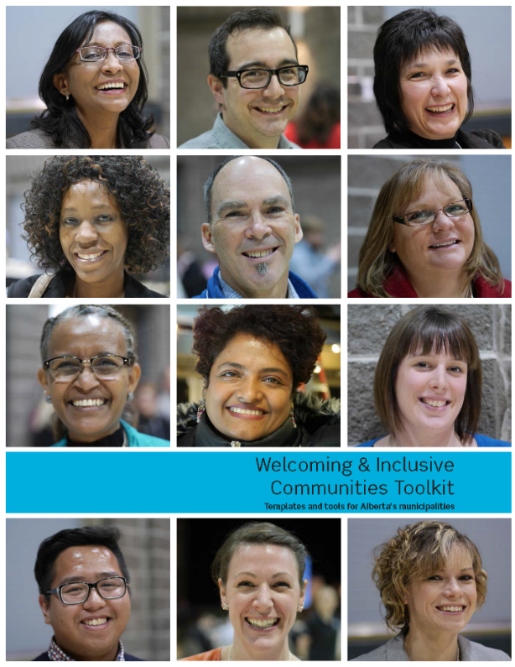
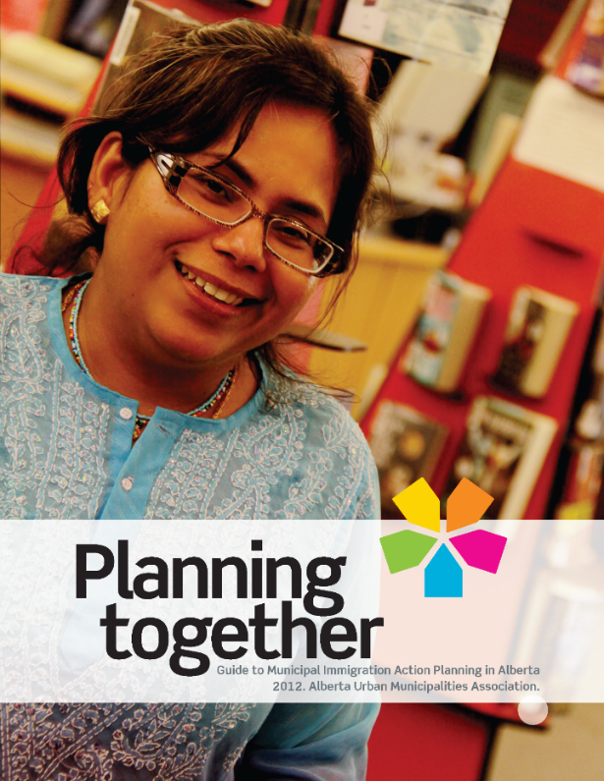
Not reinventing the wheel
Notes:
The AUMA has developed a WIC planning toolkit that walks through the different stages of a successful initiative or plan, including:
Recognition
Commitment
Vision & Plan
Action & Evaluation
Celebration
The toolkit expands on what needs to happen during each phase and provides current case studies and best practices from around the province.
The AUMA has also developed a Municipal Evaluation Tool (MET) and Municipal Action Planning guide that will help our municipal through the process.

Slide 25
Next steps

Slide 26
Next steps
wic.auma.ca
Notes:
We can approach the AUMA for more information about WIC, joining the network, what’s involved and access the resources that they have developed over the past few years

Slide 27
Next steps
Contact AUMA
Municipal Evaluation Tool
Notes:
As mentioned, the AUMA has developed a Municipal Evaluation Tool that we can administer ourselves to help determine the current state of our community. It will help us to know where we sit in terms of being welcoming and inclusive, as well as give us some ideas on the kinds of goals that we could set for ourselves.

Slide 28
Next steps
Contact AUMA
Municipal Evaluation Tool
Develop a community specific approach
Notes:
Once we know where we stand with regard to diversity and inclusion, as well as the resources that exist within our community, we can decide the approach that we want to take. Using the AUMA’s resources, we can develop an approach that is unique to our community … it can be a big, ambitious plan or it can be a series of small goals that we incorporate into plans and initiatives that are already underway. This all depends on the resources we have available and the support this has on council and within the community.

Slide 29
Questions?

